Slide 1
Team 5 – Rotor Blade Structures
Week No - 4
Date - 21.10.2025
Supervisor - Dr. Laurence Alhrshy
Presented by – Mithun Shetty
Team Members - Bhima B Masare, Anudeep Allanki, Dongsuk Kim, Mithun Shetty

Slide 2
Contents
Rotor Blade Structures Team Time line
Chord Distribution
Calculations
TSR Importance
Material Selection
Bibliography
Mithun Shetty

Slide 3
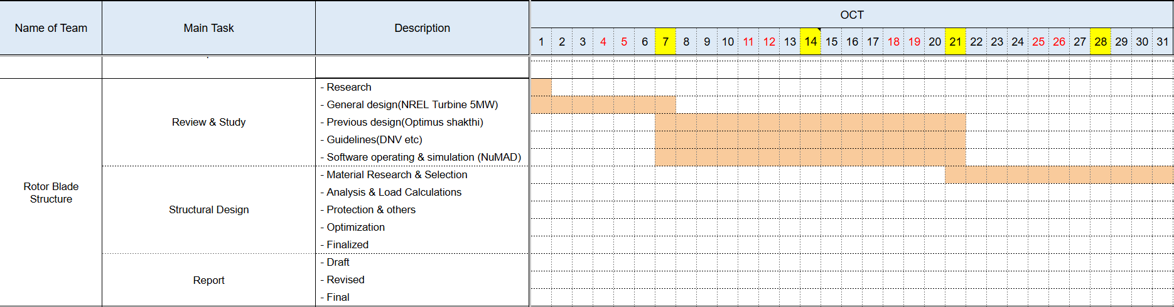
1. Rotor Blade Structures Team Time line -
1.1 Team Time line for Month October -
Mithun Shetty

Slide 4
2. Chord Distribution -
2.1 ‘Betz’ VS ‘Schmitz’ –
For chord length calculation first step is to know about Betz and Schmitz optimization as they are the ones that decides chord lengths (wider chords / narrower chords)
Feature | Betz’s Optimization | Schmitz’s Optimization
Considers Drag | No | Yes
Considers Wake | Basic momentum only | Yes (wake rotation losses)
Chord (Root/Mid) | Tends to be Wider | Tends to be Narrower (than Betz)
Chord (Tip) | Narrow | Narrow
Efficiency Goal | Theoretical Maximum | Practical Maximum
Realism | Less realistic (ignores key losses) | More realistic (accounts for major losses)
Mithun Shetty

Slide 5
2. Chord Distribution -
2.1 ‘Betz’ VS ‘Schmitz’ –
The ideal aerodynamic chord near the root is usually too narrow structurally.
Designers significantly widen the chord in this region to handle high bending moments, often using linear interpolation rather than pure aerodynamic optimization.
Maximum chord length can be limited by manufacturing capabilities or transportation restrictions.
The "Optimus Shakthi" team adjusted their Betz optimization results for this reason.
Max chord length according for Optimus Shakthi is 5.74 m
Max chord length according for NREL 5MW is 4.652 m
Mithun Shetty

Slide 6
2. Chord Distribution -
2.1 ‘Betz’ VS ‘Schmitz’ –
As per our understanding the Chord Length calculation does not depends on a single formula but we can get the chord length using the reference turbines existing data
Reference Blade: Optimus Shakthi with a blade length of 87 m
Optimus Syria Blade Length 80 m
For chord length calculation first step is to know about Betz and Schmitz optimization as they are the ones that decides chord lengths (wider chords / narrower chords)
Mithun Shetty

Slide 7
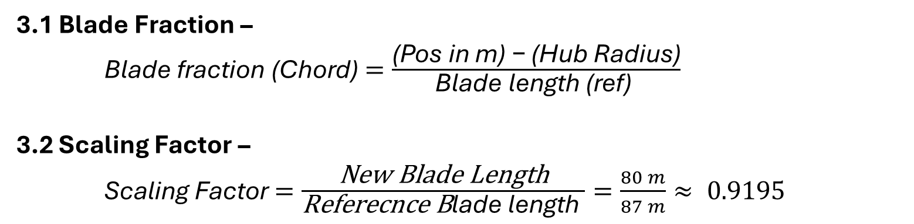
3. Calculations –
3.1 Blade Fraction –
Blade fraction (Chord) $=\frac{\text{(}\text{Pos} \text{in} \text{m}\text{)}\text{ − }\text{(}\text{Hub} \text{Radius}\text{)}}{\text{Blade} \text{length}\text{ (}\text{ref}\text{) }}$
3.2 Scaling Factor –
Scaling Factor$=\frac{\text{New} \text{Blade} \text{Length}}{\text{Referecnce} \text{B}\text{lade} \text{length} }=\frac{80 m}{87 m}≈ 0.9195$
Mithun Shetty

Slide 8
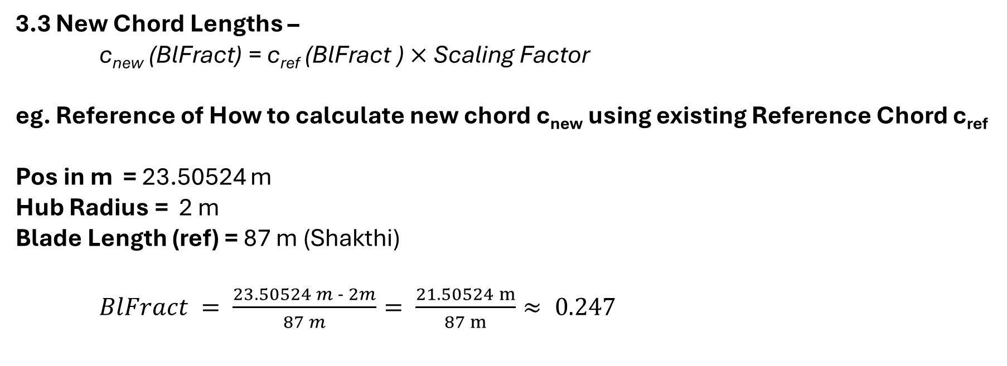
3. Calculations –
3.3 New Chord Lengths –
c_{new} (BlFract) = c_{ref} (BlFract ) $×$Scaling Factor
eg. Reference of How to calculate new chord c_{new} using existing Reference Chord c_{ref} Pos in m = 23.50524 m Hub Radius = 2 m Blade Length (ref) = 87 m (Shakthi)
$BlFract = \frac{23.50524 m - 2m}{87 m}= \frac{21.50524 m}{87 m}≈ 0.247$
Mithun Shetty

Slide 9
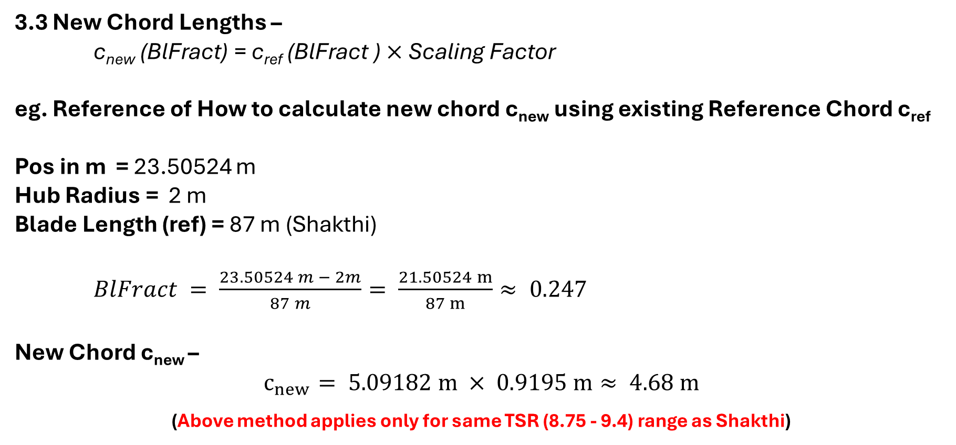
3. Calculations –
3.3 New Chord Lengths –
c_{new} (BlFract) = c_{ref} (BlFract ) $×$Scaling Factor
eg. Reference of How to calculate new chord c_{new} using existing Reference Chord c_{ref} Pos in m = 23.50524 m Hub Radius = 2 m Blade Length (ref) = 87 m (Shakthi)
$BlFract = \frac{23.50524 m − 2m}{87 m}= \frac{21.50524 m}{87 m}≈ 0.247$
New Chord c_{new} –
$$c_{new}= 5.09182 m × 0.9195 m≈ 4.68 m$$
(Above method applies only for same TSR (8.75 - 9.4) range as Shakthi)
Mithun Shetty

Slide 10
4. TSR Importance –
4.1 Why TSR Matters for Chord –
The optimal chord length at each section is linked to the TSR because TSR influences the relative wind speed and angle that each part of the blade experiences
A different TSR changes these relative angles, meaning the original chord distribution might no longer be the best for maximizing lift and minimizing drag at your target TSR
Mithun Shetty

Slide 11
4. TSR Importance –
4.2 What Needs to Change (Ideally) –
Re-Optimization: ( Depends on Aerodynamics Team)
The accurate approach is to perform a new aerodynamic optimization using BEM software (like Q Blade)
During this re-optimization, we must input our target TSR along with the 80m blade length and chosen airfoils
The software would then calculate a new, optimized chord (and twist) distribution specifically tailored to achieve maximum C_{p} at your target TSR
If re-optimization not possible C_{p} slightly lower than the value of C_{p} at optimized TSR
Mithun Shetty

Slide 12
5. Material Selection -
5.1 Key factors to be considered –
Strength-to-Weight Ratio
Stiffness (Young's Modulus)
Fatigue Resistance
Shear and Torsional Strength (Shear Modulus)
Manufacturability
Cost
Environmental Resistance
Mithun Shetty

Slide 13
5. Material Selection -
5.2 Material Choices from References –
Sandia 61.5 m Blade –
Primarily E-glass (UD and TRIAX), Carbon UD (for spar caps), Foam core, Gelcoat
Optimus Shakthi 87 m Blade –
GFRP (BIAX and TRIAX), CFRP (UD for spar caps), Foam and Balsa cores, Adhesives, Gelcoat
Mithun Shetty

Slide 14
Bibliography
Definition of a 5 MW/61.5m Wind Turbine Blade Reference Model by Brian R. Resor, Sandia National Laboratories, California, USA
Definition of a 5 MW Reference Wind Turbine for Offshore System Development, J. Jonkman, S. Butterfield, W. Musial, and G. Scott, National Renewable Energy Laboratory, USA
Reports from Optimus Shakthi 2024
Mithun Shetty

